Slide 1
CS 3358: Data Structures and Algorithms
Jishnu Banerjee

Slide 2
Last Class Summary
Implementing Stack
Queue
Queue Examples
Implementing Queue

Slide 3
Templates
Generic Programming
Writing the same function for all the different data types
int maximum(int a, int b)
{
if (a > b)
return a;
else
return b;
}

Slide 4
Templates
Generic Programming
Writing the same function for all the different data types
double maximum(double a, double b)
{
if (a > b)
return a;
else
return b;
}

Slide 5
Template Function
Template functions can be used with many data types
When you write a template function, you name a data type for the function
template <typename T>
T maximum(T a, T b)
{
if (a > b)
return a;
else
return b;
}

Slide 6
Example Template Function
template <typename T>
T maximum(T x, T y) {
if (x > y) return x;
else return y;
}
int main(void) {
int x = 0;
cout << maximum<int>(x, ++x); // prints 1
cout << x; // prints 1
string s = “hello”;
string t = “world”;
cout << maximum<string>(s, t); // prints “world”
}
Do Not
Mix different
data types

Slide 7
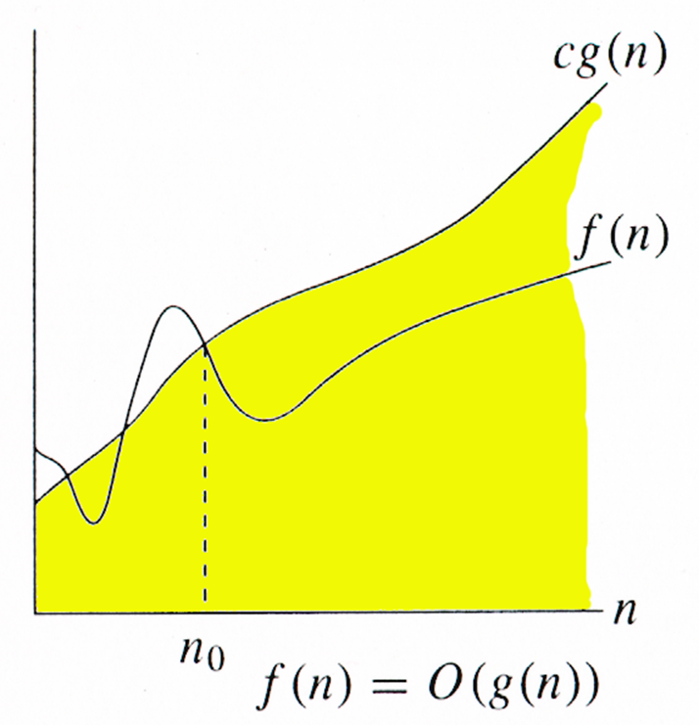
Big-O Notation
For a given function g(n), we can write
O(g(n)) = {f(n): there exist non-negative constants c and n₀ such that
0 ≤ f(n) ≤ cg(n)
for all n ≥ n₀ }

Slide 8
Big-O Notation
T(n) = 33n² + 5n +8
≤ 33n² + 5n² +8n², for all n ≥ 1
≤ 46n², for all n ≥ 1
Thus, letting c = 46 and n₀ = 1 proves that
33n² + 5n +8 = O(n²)

Slide 9
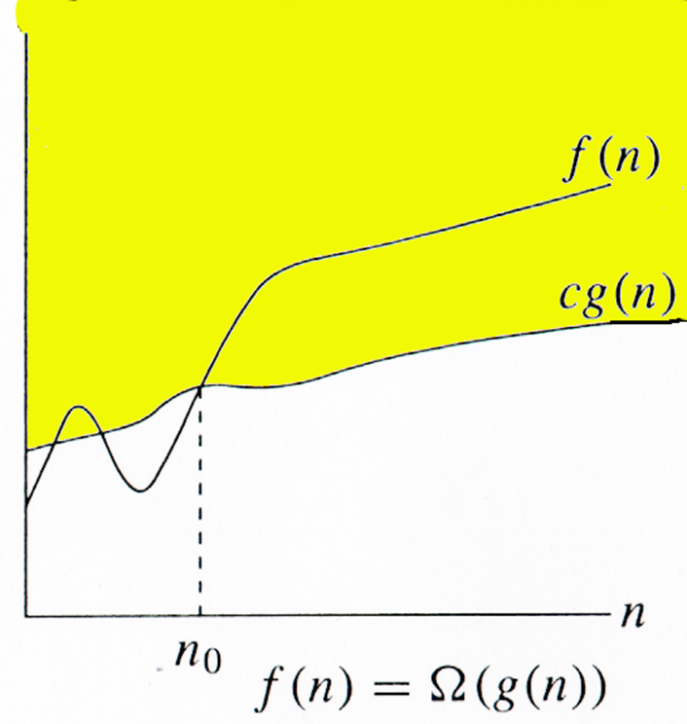
Big-Ω Notation
For a given function g(n), we can write
Ω(g(n)) = {f(n): there exist non-negative constants c and n₀ such that
0 ≤ cg(n) ≤ f(n)
for all n ≥ n₀ }

Slide 10
Big-Ω Notation
T(n) = 33n² + 5n +8
≥ 33n², for all n ≥ 0
Thus, letting c = 33 and n₀ = 0 proves that
33n² + 5n +8 = Ω(n²)

Slide 11
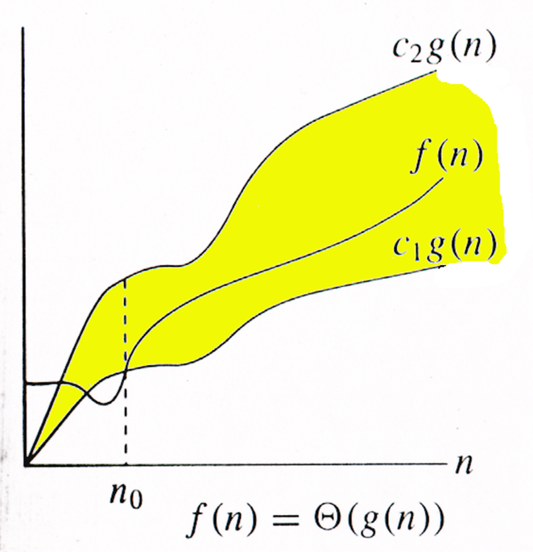
Big-Θ Notation
For a given function g(n), we can write
Θ(g(n)) = {f(n): there exist non-negative constants c₁, c₂ and n₀ such that 0 ≤ c₁g(n) ≤ f(n) ≤ c₂g(n), for all n ≥ n₀ }

Slide 12
Big-Θ Notation
33n² + 5n +8 = Θ(n²)
it’s both O(n²) and Ω(n²)
not Θ(n³) : O(n³) but not Ω(n³)
not Θ(n) : Ω(n) but not O(n)

Slide 13
Running Time
“The running time is O(g(n))”
⇒ Worst case is O(g(n))
“Running time is Ω(g(n))”
⇒ Best case is Ω(g(n))
“Running time is Θ(g(n))”
⇒ Tight case is Θ(g(n))

Slide 14
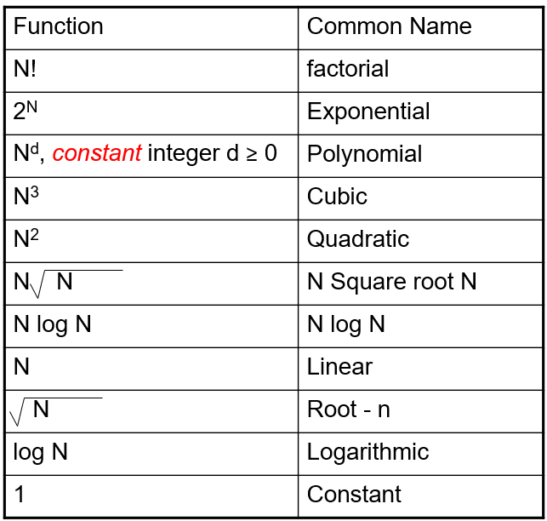
Typical Big-O Functions

Slide 15
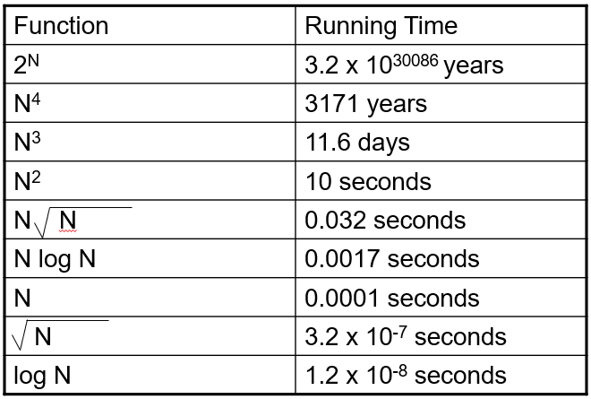
Big-O Runtime
Assume N = 100,000
processor speed is 1,000,000,000 operations per second

Slide 16
Big-O Runtime
Basic operations take “constant” time – O(1)
Built-in arithmetic/ Boolean operators
Assignment
Access one value pointed by a pointer or array index
Variable declarations
More complex operations:
Consecutive statements – sum of times
Loops – sum of (time of) iterations
Conditionals – time to test + time of slower branch
Calls – time of method body

Slide 17
Big-O Runtime: Example
1 + 2 + 3 + 4 + … + N
= N(N+1)/2 = N²/2 + N/2 is O(N²)
N + N + N + …. + N (total of N times)
= N*N = N² which is O(N²)
1 + 2 + 4 + 8 + … + 2^{N}
= 2^{N+1} – 1 = 2 x 2^{N} – 1 which is O(2^{N} )

Slide 18
Coding Example
//Code 1
for(i=0; i < n; i++)
sum = sum + 1;
//Code 2
for(i=0; i < n; i++)
for(j=0; j < n; j++)
sum2 = sum2 + 1;
//Code 3
for(i=0; i < n; i++)
sum = sum + 1;
for(i=0; i < n; i++)
sum = sum + i;
O(n)
O(n²)
O(n)

Slide 19
Coding Example
// pre n > 0
int foo(int n)
{
int total = 0;
while (n > 0)
{
n = n / 2;
total++;
}
return total;
}
O(log₂n)

Slide 20
Coding Example
// pre n > 0
int foo(int n)
{
int total = 0;
while (n > 0)
{
n = n / 5;
total++;
}
return total;
}
O(log₅n)

Slide 21
Coding Example
// pre n > 0
int foo(int n)
{
int total = 0;
while (n > 0)
{
n = n / k;
total++;
}
return total;
}
O(log_{k}n)

Slide 22
Search Algorithm
Suppose you want to a find a student in the Texas State directory.
It contains NetIDs, names, phone numbers, lots of other information.
You want a computer application for searching the directory: given a NetID, return the student’s name.
Linear Search?

Slide 23
Time Complexity: Linear Search
best case (minimum amount of work):
NetID found in student₁
1 loop iteration
worst case (maximum amount of work):
NetID found in student_{n}
n loop iterations
average case (expected amount of work):
NetD found in student_{n/2}
n/2 loop iterations
Complexity: O(n)

Slide 24
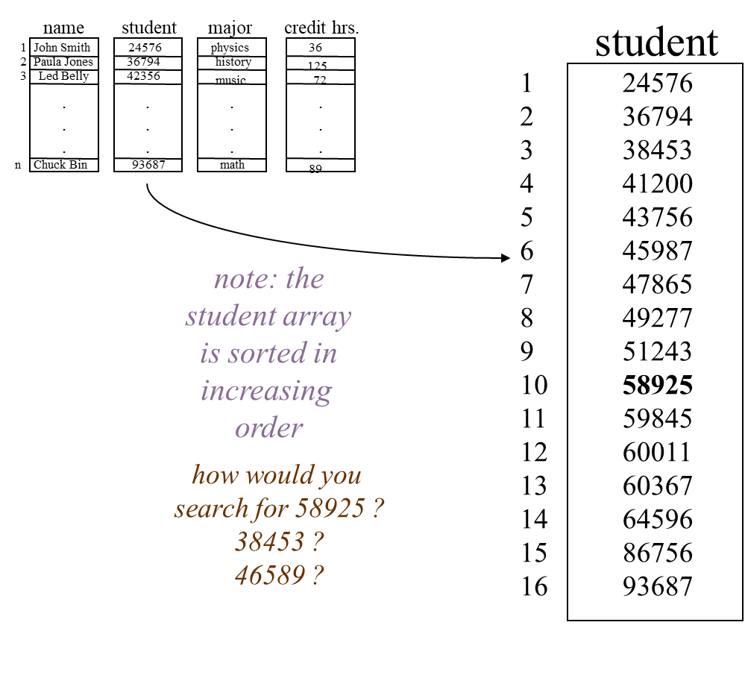
Binary Search

Slide 25
Binary Search
1. ask user to input studentNum to search for
2. set beginning to 1
3. set end to n
4. set found to ‘no’
5. while beginning <= end and found = ‘no’
6. set middle to (beginning + end) / 2 {round down to nearest integer}
7. if studentNum = student_{middle} then set found to ‘yes’
8. if studentNum < student_{middle} then set end to middle - 1
9. if studentNum > student_{middle} then set beginning to middle + 1
10.if found = ‘no’ then print “no such student”
else <studentNum found at array index middle>

Slide 26
Binary Search
1. ask user to input studentNum to search for
2. set beginning to 1
3. set end to n
4. set found to ‘no’
5. while beginning <= end and found = ‘no’
6. set middle to (beginning + end) / 2 {round down to nearest integer}
7. if studentNum = student_{middle} then set found to ‘yes’
8. if studentNum < student_{middle} then set end to middle - 1
9. if studentNum > student_{middle} then set beginning to middle + 1
10.if found = ‘no’ then print “no such student”
else <studentNum found at array index middle>

Slide 27
Binary Search
1. ask user to input studentNum to search for
2. set beginning to 1
3. set end to n
4. set found to ‘no’
5. while beginning <= end and found = ‘no’
6. set middle to (beginning + end) / 2 {round down to nearest integer}
7. if studentNum = student_{middle} then set found to ‘yes’
8. if studentNum < student_{middle} then set end to middle - 1
9. if studentNum > student_{middle} then set beginning to middle + 1
10.if found = ‘no’ then print “no such student”
else <studentNum found at array index middle>

Slide 28
Binary Search
1. ask user to input studentNum to search for
2. set beginning to 1
3. set end to n
4. set found to ‘no’
5. while beginning <= end and found = ‘no’
6. set middle to (beginning + end) / 2 {round down to nearest integer}
7. if studentNum = student_{middle} then set found to ‘yes’
8. if studentNum < student_{middle} then set end to middle - 1
9. if studentNum > student_{middle} then set beginning to middle + 1
10.if found = ‘no’ then print “no such student”
else <studentNum found at array index middle>

Slide 29
Binary Search
1. ask user to input studentNum to search for
2. set beginning to 1
3. set end to n
4. set found to ‘no’
5. while beginning <= end and found = ‘no’
6. set middle to (beginning + end) / 2 {round down to nearest integer}
7. if studentNum = student_{middle} then set found to ‘yes’
8. if studentNum < student_{middle} then set end to middle - 1
9. if studentNum > student_{middle} then set beginning to middle + 1
10.if found = ‘no’ then print “no such student”
else <studentNum found at array index middle>

Slide 30
Binary Search
1. ask user to input studentNum to search for
2. set beginning to 1
3. set end to n
4. set found to ‘no’
5. while beginning <= end and found = ‘no’
6. set middle to (beginning + end) / 2 {round down to nearest integer}
7. if studentNum = student_{middle} then set found to ‘yes’
8. if studentNum < student_{middle} then set end to middle - 1
9. if studentNum > student_{middle} then set beginning to middle + 1
10.if found = ‘no’ then print “no such student”
else <studentNum found at array index middle>

Slide 31
Binary Search
1. ask user to input studentNum to search for
2. set beginning to 1
3. set end to n
4. set found to ‘no’
5. while beginning <= end and found = ‘no’
6. set middle to (beginning + end) / 2 {round down to nearest integer}
7. if studentNum = student_{middle} then set found to ‘yes’
8. if studentNum < student_{middle} then set end to middle - 1
9. if studentNum > student_{middle} then set beginning to middle + 1
10.if found = ‘no’ then print “no such student”
else <studentNum found at array index middle>

Slide 32
Binary Search
1. ask user to input studentNum to search for
2. set beginning to 1
3. set end to n
4. set found to ‘no’
5. while beginning <= end and found = ‘no’
6. set middle to (beginning + end) / 2 {round down to nearest integer}
7. if studentNum = student_{middle} then set found to ‘yes’
8. if studentNum < student_{middle} then set end to middle - 1
9. if studentNum > student_{middle} then set beginning to middle + 1
10.if found = ‘no’ then print “no such student”
else <studentNum found at array index middle>

Slide 33
Binary Search
1. ask user to input studentNum to search for
2. set beginning to 1
3. set end to n
4. set found to ‘no’
5. while beginning <= end and found = ‘no’
6. set middle to (beginning + end) / 2 {round down to nearest integer}
7. if studentNum = student_{middle} then set found to ‘yes’
8. if studentNum < student_{middle} then set end to middle - 1
9. if studentNum > student_{middle} then set beginning to middle + 1
10.if found = ‘no’ then print “no such student”
else <studentNum found at array index middle>

Slide 34
Binary Search
1. ask user to input studentNum to search for
2. set beginning to 1
3. set end to n
4. set found to ‘no’
5. while beginning <= end and found = ‘no’
6. set middle to (beginning + end) / 2 {round down to nearest integer}
7. if studentNum = student_{middle} then set found to ‘yes’
8. if studentNum < student_{middle} then set end to middle - 1
9. if studentNum > student_{middle} then set beginning to middle + 1
10.if found = ‘no’ then print “no such student”
else <studentNum found at array index middle>

Slide 35
Binary Search
1. ask user to input studentNum to search for
2. set beginning to 1
3. set end to n
4. set found to ‘no’
5. while beginning <= end and found = ‘no’
6. set middle to (beginning + end) / 2 {round down to nearest integer}
7. if studentNum = student_{middle} then set found to ‘yes’
8. if studentNum < student_{middle} then set end to middle - 1
9. if studentNum > student_{middle} then set beginning to middle + 1
10.if found = ‘no’ then print “no such student”
else <studentNum found at array index middle>

Slide 36
Binary Search
1. ask user to input studentNum to search for
2. set beginning to 1
3. set end to n
4. set found to ‘no’
5. while beginning <= end and found = ‘no’
6. set middle to (beginning + end) / 2 {round down to nearest integer}
7. if studentNum = student_{middle} then set found to ‘yes’
8. if studentNum < student_{middle} then set end to middle - 1
9. if studentNum > student_{middle} then set beginning to middle + 1
10.if found = ‘no’ then print “no such student”
else <studentNum found at array index middle>
Complexity: O(log₂n)

Slide 37
Today's Summary
Templates
Big-O Notation
Big-Omega Notation
Big-Theta Notation
Runtime
Coding Example
Search Algorithm Complexity Comparison
Binary Search

